Slide 1

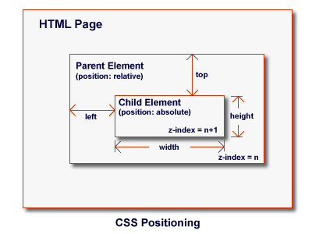


CSS Formatting
CSS Fonts, Borders, Backgrounds
CSS Formatting
SoftUni Team
Technical Trainers
Software University
http://softuni.bg

Slide 2
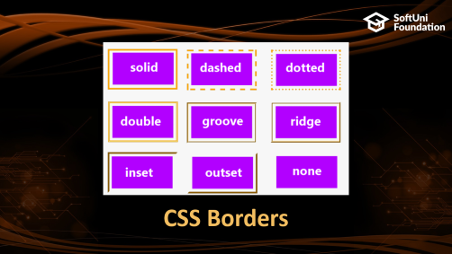
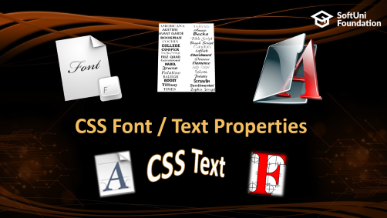
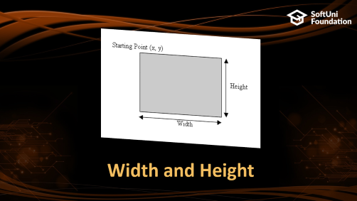

Table of Contents

Slide 3
Have a Question?
sli.do #front-end

Slide 4

CSS Font / Text Properties
Styling Texts

Slide 5
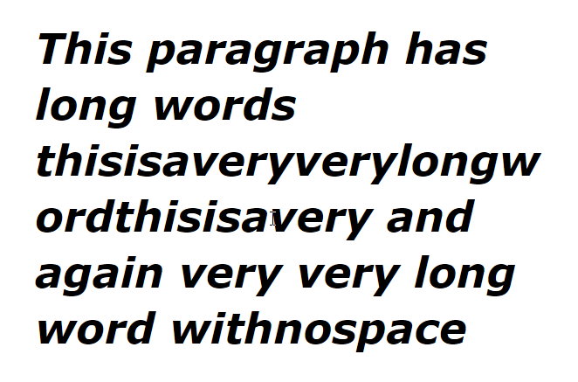
Font Property
CSS font property
font: italic normal bold 12px/16px Verdana
font-style: italic;
font-variant: normal;
font-weight: bold;
font-size: 12px;
line-height: 16px;
font-family: Verdana;

Slide 6
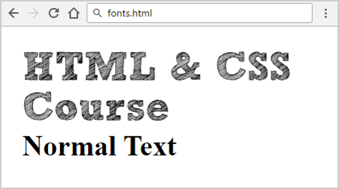
Font Embedding
<h1>HTML & CSS Course</h1>
<h2>Normal Text</h2>
@font-face {
font-family: SketchRockwell;
src: url('fonts/SketchRockwell.ttf')
}
h1 {
font-family: SketchRockwell;
font-size: 3.5em
}

Slide 7
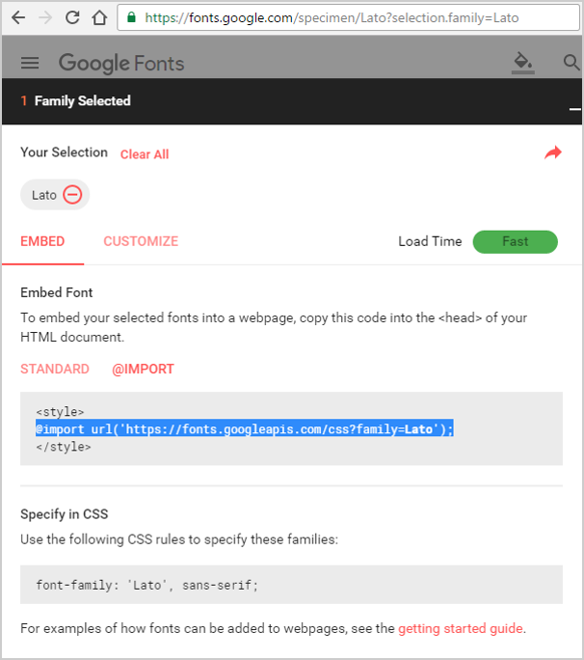

Importing "Lato" from Google Font Directory
@import url('https://fonts.googleapis.com/css?family=Lato');
body {
font-family:
Lato, Arial, sans-serif;
}
serif font
sans-serif font

Slide 8
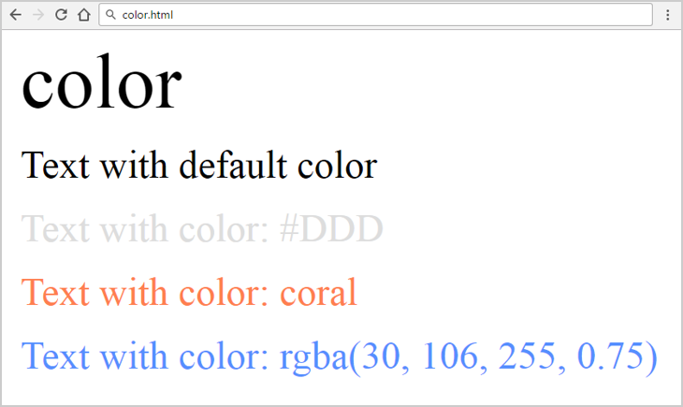
CSS Font Rules: Color
<h1>color</h1>
<p>Text with default color</p>
<p class="color-ddd">Text…</p>
<p class="color-coral">Text…</p>
<p class="color-rgba">Text…</p>
.color-ddd {
color:#DDD;
}
.color-coral {
color:coral;
}
.color-rgba {
color:
rgba(30, 106, 255, 0.75)
}

Slide 9
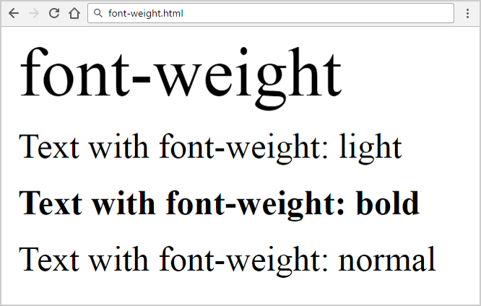
CSS Font Rules: Font-Weight
<p class="weight-light">Text…</p>
<p class="weight-bold">Text…</p>
.weight-light {
font-weight: light;
}
.weight-bold {
font-weight: bold;
}
Check more font-weight: https://css-tricks.com/almanac/properties/f/font-weight/

Slide 10
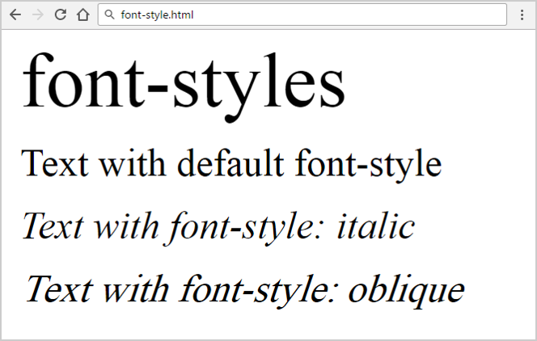
CSS Font Rules: Font-Style
<p class="font-style-italic">Text…</p>
<p class="font-style-oblique">Text…</p>
.font-style-italic {
font-style: italic;
}
.font-style-oblique {
font-style: oblique;
}
Check more font-style: https://css-tricks.com/almanac/properties/f/font-style/

Slide 11
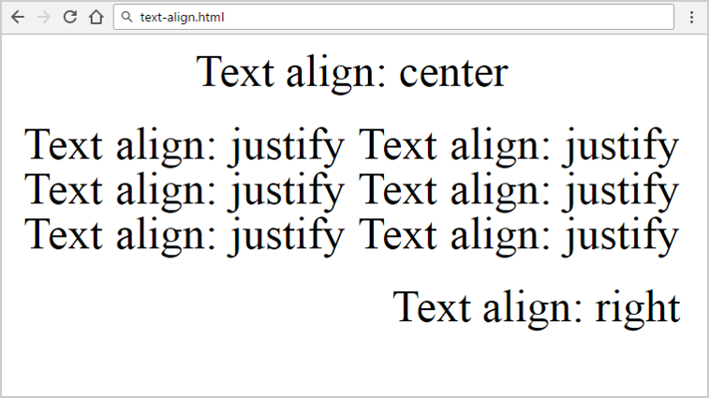
CSS Font Rules: Text-Align
<p class="text-align-center">Text…</p>
<p class="text-align-justify">Text…</p>
.text-align-center {
text-align: center;
}
.text-align-justify {
text-align: justify;
}
Check more text-align: https://css-tricks.com/almanac/properties/t/text-align/

Slide 12
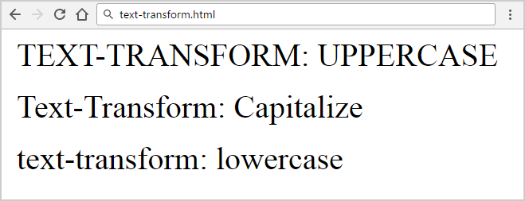
CSS Font Rules: Text-Transform
<p class="uppercase">Text…</p>
<p class="capitalize">Text…</p>
.uppercase {
text-transform: uppercase;
}
.capitalize {
text-transform: capitalize;
}
Check more text-transform: https://css-tricks.com/almanac/properties/t/text-transform/

Slide 13
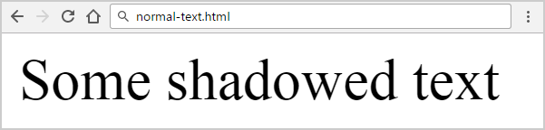
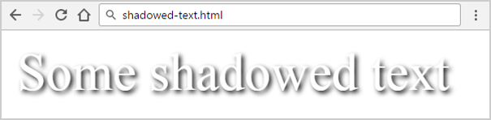
Text Shadow
<blur radius>
<shadow
color>
p {
text-shadow: 2px 2px 7px #000; }
<horizontal
distance>
<vertical
distance>

Slide 14
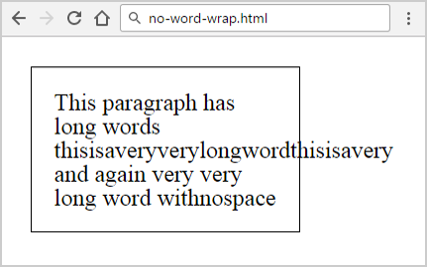
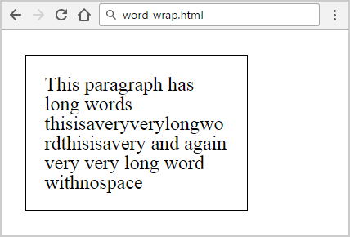
Word Wrapping
<p>This paragraph…</p>
p {
word-wrap: normal;
}
p {
word-wrap: break-word;
}

Slide 15
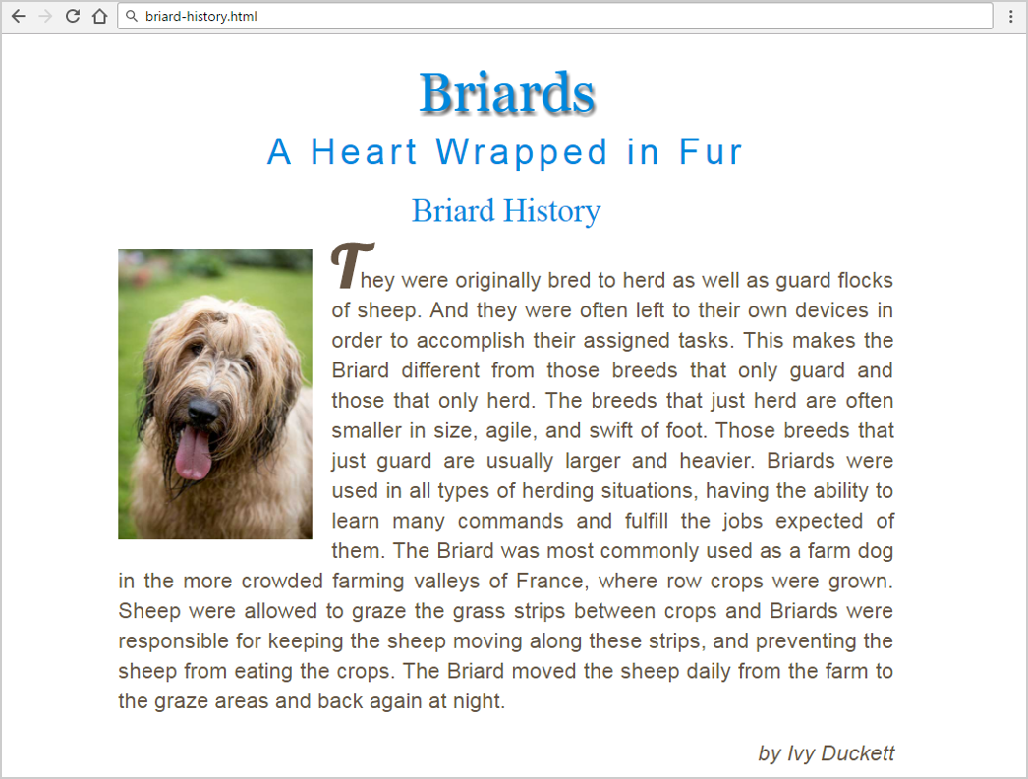
Problem: Briard History

Slide 16

Solution: Briard History (HTML)
<main>
<h1>Briards</h1>
<h2>A Heart wrapped <span>in</span> fur</h2> <article>
<header>
<h3><a class="breed" href="https://en.wikipedia.org/wiki/Briard"> Briard History</a></h3>
</header>
<img src="briard.jpg" alt="briard">
<p><!—TODO put the text here…--></p>
<p class="credits">by Ivy Duckett</p>
</article>
</main>
Check your solution here: https://judge.softuni.bg/Contests/799

Slide 17
Solution: Briard History (CSS)
@import url("https://fonts.googleapis.com/css?family=Lobster");
html { font-size: 16px; }
main {
margin: 0 auto;
width: 800px;
padding: 20px; }
h1, h2, h3, a {
font-weight: normal;
color: #0088dd;
margin: 0;
text-align: center;
font-size: 2.1rem;
text-decoration: none; }
h1 {
font-family: Georgia,Times,serif;
font-size: 3.5em;
text-shadow: 2px 4px 4px #666666;
padding-bottom: 10px;
text-transform: capitalize; }
h2 {
font-family: Arial,sans-serif;
font-size: 2.3rem;
text-transform: capitalize;
letter-spacing: 0.3rem }
h2 span {
text-transform: none; }

Slide 18
Solution: Briard History (More CSS)
article {
margin-top: 20px;
text-align: justify; }
p {
font-family: Arial, Verdana, sans-serif;
line-height: 30px;
color: #665544;
font-size: 1.4rem;
}
.credits {
font-style: italic;
text-align: right;
}
header {
margin-bottom: 20px;
}
img {
width: 200px;
float: left;
margin-right: 20px;
}
p:first-of-type:first-letter {
font-weight: bold;
font-size: 3.8rem;
font-family: 'Lobster', cursive;
text-transform: uppercase;
}

Slide 19
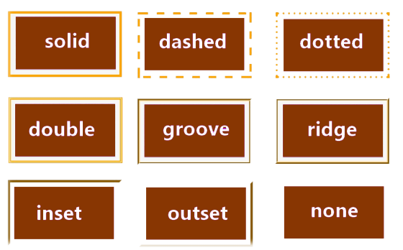
CSS Borders

Slide 20
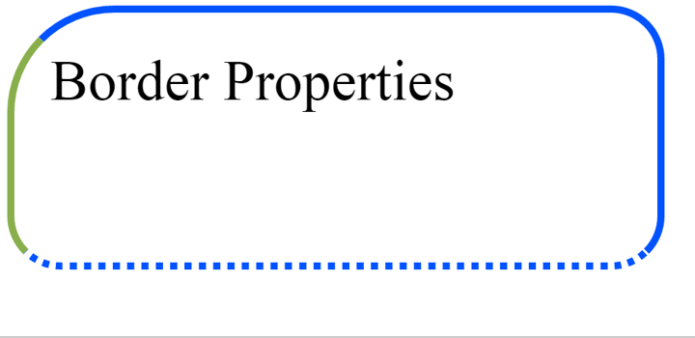
Border Properties
div {
width: 160px;
height: 50px;
border-width: 2px;
border-style: solid;
border-color: #0053ff;
border-radius: 15px;
border-top-left-radius: 30px;
border-bottom-style: dotted;
border-left-color: #89AF4C;
}

Slide 21
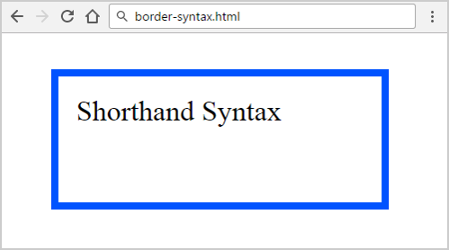
Border Shorthand Property
<div>Short Syntax</div>
border-width
border-style
div {
border: 4px solid #0053ff;
width: 160px;
height: 50px;
}
border-color

Slide 22
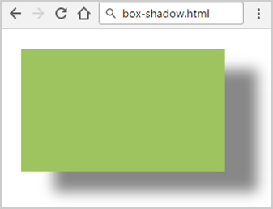
Box Shadow
.box {
margin: 5px;
width: 50px;
height: 30px;
background: #9DC45F;
box-shadow: 8px 5px 5px #888;
}
blur
color
offset-x
offset-y

Slide 23
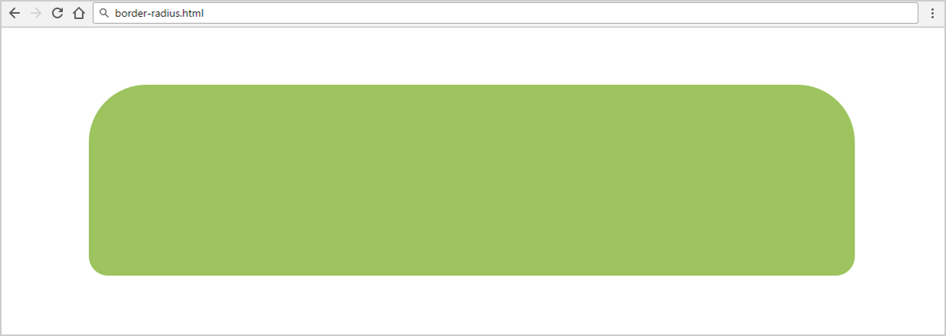
Border Radius
top-left
top-right
.rounded {
border-radius: 15px 15px 5px 5px;
}
bottom-right
bottom-left

Slide 24
Problem : Autumn
You are given a HTML file
Create a Web page like the screenshots on the next slides
Constraints:
You are NOT allowed to change the HTML file
Just write the missing CSS

Slide 25
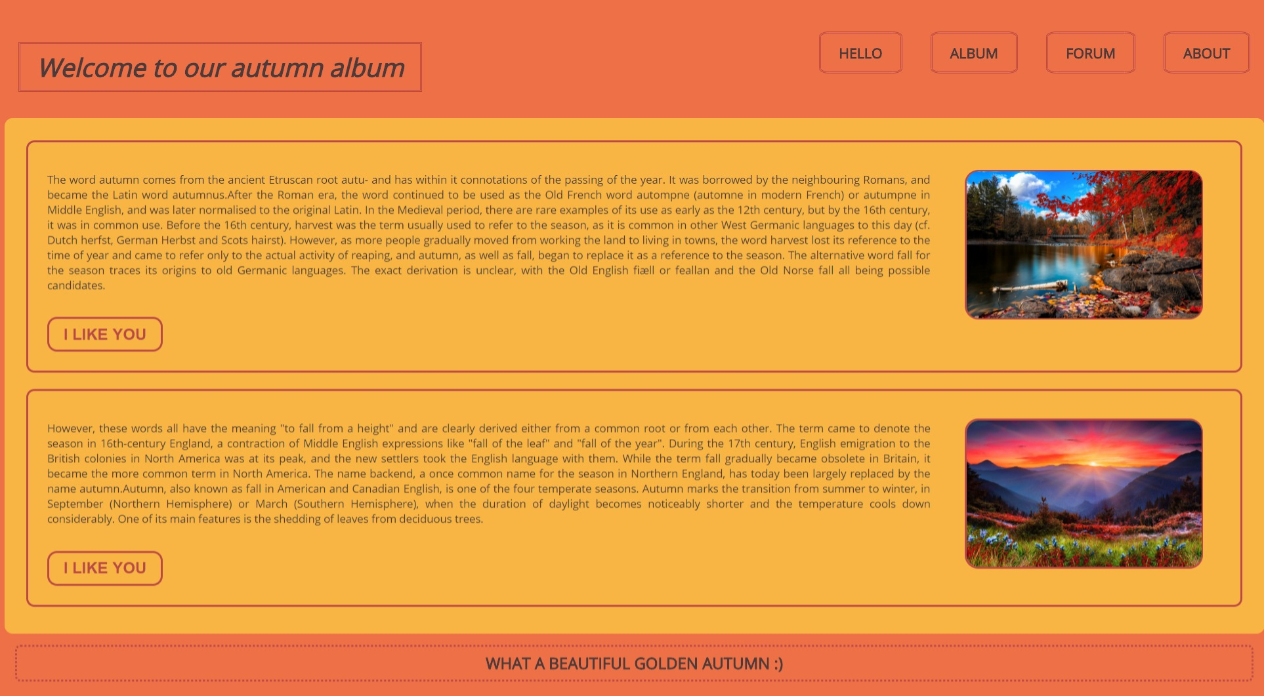
Problem : Autumn

Slide 26
Solution: Autumn – CSS (1)
@import url('https://fonts.googleapis.com/css?family=Open+Sans');
body {
background-color: #ED7046;
font-family: 'Open sans', sans-serif;
}
header {
margin-top: 2%;
}
header h1 {
border: double #BB4846;
display: inline;
padding: 11px 31px;
font-size: 46px;
color: #4d3a3a;
font-style: italic;
font-weight: 900;
position: relative;
top: 37px;
left: 26px; }
li {
display: inline-block;
float: right;
padding-top: 55px; }

Slide 27
Solution: Autumn – CSS (2)
nav a {
text-decoration: none;
padding: 17px 33px;
border: 4px double #BB4846;
margin: 25px;
color: #4d3a3a;
background: none;
border-radius: 12%;
text-transform: uppercase;
font-size: 1.6rem;
font-weight: bold; }
main section article {
border: double 3px #BB4846;
. . .
border-radius: 15px;
padding: 35px;
margin: 20px 20px 30px;
}
section {
height: auto;
padding: 20px;
margin-top: 100px;
background: #F9B544;
border-radius: 15px;
text-align: justify;
text-justify: inter-word;
}

Slide 28
Solution: Autumn – CSS (3)
section article figure {
float: right;
width: 20%;
margin-left: 63px;
}
img {
width: 100%;
height: 100%;
border: 3px solid #BB4846;
border-radius: 25px;
}
button {
border: 3px solid #BB4846;
background: transparent;
color: #BB4846;
padding: 12px 27px;
margin-top: 25px;
text-transform: uppercase;
font-size: 1.8rem;
border-radius: 18px;
font-weight: bold;
outline: none;
}

Slide 29
Solution: Autumn – CSS (4)
footer {
border: dotted #BB4846;
border-radius: 10px;
color: #4d3a3a;
text-align: center;
margin: 20px;
font-weight: 900;
font-size: 1.8rem;
text-transform: uppercase;
padding: 10px 3px;
}
button:hover, a:hover {
color: white;
background: #BB4846;
font-style: italic;
font-weight: bold;
cursor: pointer;
}

Slide 30

CSS Background Properties

Slide 31
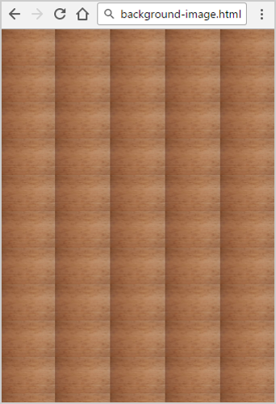
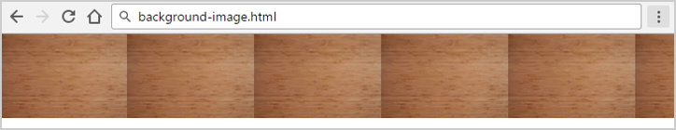
Background (Background-Image)
body {
background-image: url(img/bgr.png);
background-repeat: repeat;
background-repeat: repeat-x;
background-repeat: repeat-y;
background-repeat: no-repeat;
}
repeat
repeat-x

Slide 32
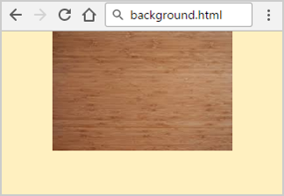
Background Shorthand Property
background-color
background-image
background-repeat
body {
background: #FFF0C0 url(img.jpg) no-repeat fixed top;
}
background-attachment
background-position

Slide 33
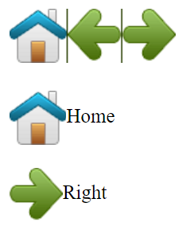
CSS Sprites: Multiple Images in a Single File
<img src="img_navsprites.gif"><br><br>
<img id="home" src="img_trans.gif">Home<br><br>
<img id="next" src="img_trans.gif">Right
#home {
width: 46px; height: 44px;
background: url(img_navsprites.gif) 0 0;
vertical-align: middle; }
#next {
width: 43px;
background: url(img_navsprites.gif) -91px 0;
vertical-align: middle; }
Use negative value: move left by 91px

Slide 34
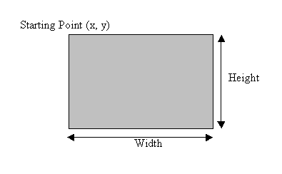
Width and Height

Slide 35
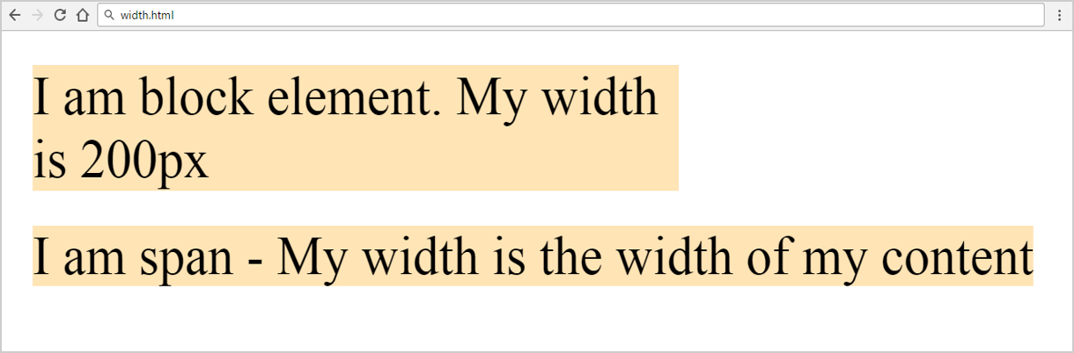
Width, Max-Width, Min-Width
Block elements have width / height
Inline elements don't have
p {
width: 50%;
min-width: 120px;
max-width: 220px;
}
div, span { width: 200px; }
<div>
I am block …
</div>
<span>
I am span …
</span>

Slide 36
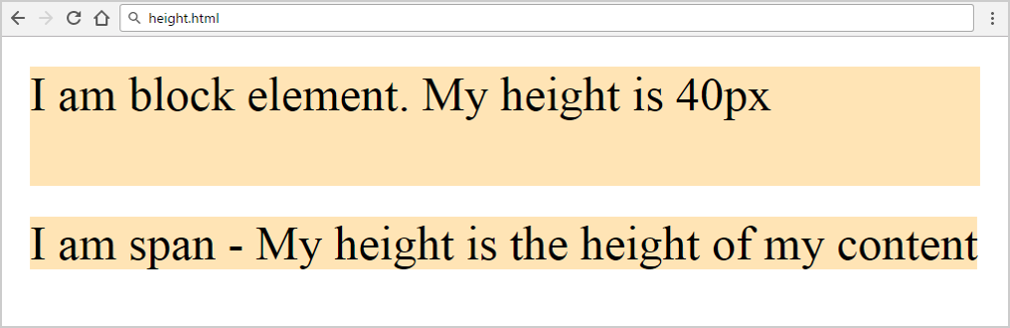
Height, Min-Height, Max-Height
p {
height: 50%;
min-height: 50px;
max-height: 100px;
}
Block elements have width / height
Inline elements don't have
div, span { height: 40px; }
<div>
I am block …
</div>
<span>
I am span …
</span>

Slide 37
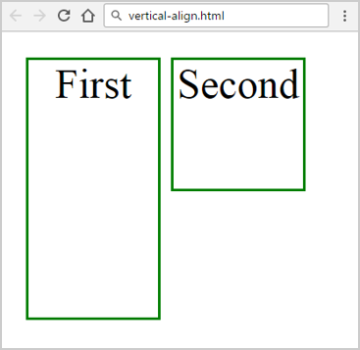
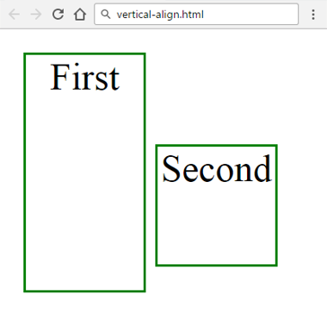
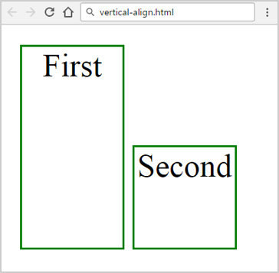
Inline-Block Elements: Vertical-Align
top
middle
bottom
.boxes li {
display: inline-block;
text-align: center;
width: 50px;
border: 1px solid green;
}
.boxes li:nth-child(1) {
height: 100px;
vertical-align: top;
}
.boxes li:nth-child(2) {
height: 50px; }

Slide 38

Summary
Fonts
Borders
Backgrounds
Width and Height
@font-face {font-family: Lato;}
border: 4px solid #FFFFFF;
background: #FFFFFF url(“img.jpg") no-repeat fixed center;
height: 200px;
width: 50%;

Slide 39







Web Fundamentals – Course Introduction
https://softuni.bg/courses/web-fundamentals-html5

Slide 40






SoftUni Diamond Partners

Slide 41






SoftUni Diamond Partners

Slide 42
License
This course (slides, examples, demos, videos, homework, etc.) is licensed under the "Creative Commons Attribution-NonCommercial-ShareAlike 4.0 International" license

Slide 43





Trainings @ Software University (SoftUni)
Software University – High-Quality Education, Profession and Job for Software Developers
softuni.bg
Software University Foundation
http://softuni.foundation/
Software University @ Facebook
facebook.com/SoftwareUniversity
Software University Forums
forum.softuni.bg

